Slide 1
Validation in Struts
Author: DoanNX
Version 2.0/Time: 30’

Slide 2
The ways to solve it
There are 2 main ways:
Client-side:
Using JavaScript (now one very good option is JQuery).
Server-side:
Manually.
Automatically (using Struts Validator Framework).

Slide 3
Client-side Validation
Using JavaScript.
Do it yourself.

Slide 4
Server-side Validation Manually
Manually.
Automatically (using Struts Validator Framework).

Slide 5
Server-side Validation Manually
Execute manually:
Performing in the Action classes:
Most powerful, we can access to BL as well as DB.
It requires repetition in multiple Actions.
We must map conditions back to the input page.
Do validation in the form bean (ActionForm):
In individual setter methods.
Using the validate methods:
It doesn’t require repetition in multiple Actions.
It will automatically redisplay input page.

Slide 6
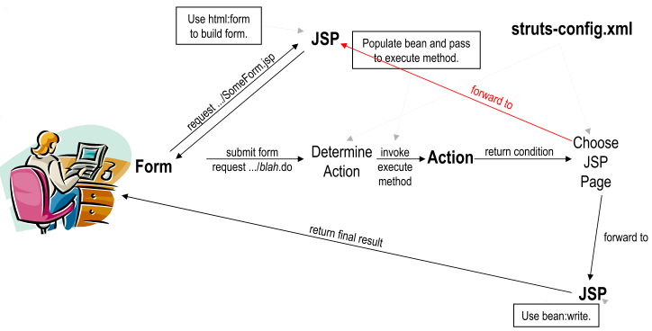
Server-side Validation Manually
Fig 1. Flow of Control when performing validation in the Action classes.

Slide 7
Server-side Validation Manually
Performing in the Action classes:
Start normally:
Cast ActionForm to specific type.
Call getter methods to retrieve field values.
For each missing or invalid value:
Add an error message to a bean.
Use mapping.findForward to return error code.
Use struts-config.xml to map the error code back to the input form.
Use bean:write to output error messages in input form.

Slide 8
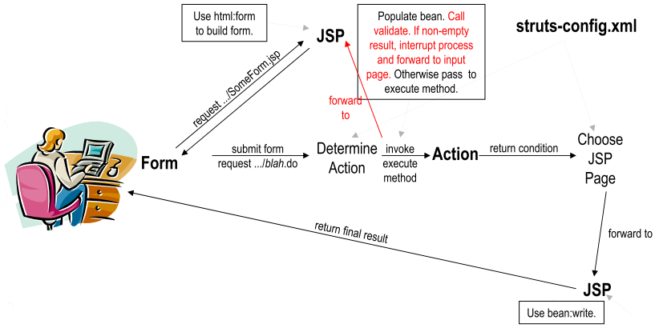
Server-side Validation Manually
Fig 2. Flow of Control when performing validation in the ActionForm classes.

Slide 9
Server-side Validation Manually
Do validation in the form bean (ActionForm):
Using validate() method of ActionForm class:
If no errors, return null or an empty ActionErrors object.
For each error, add ActionMessage entries to ActionErrors:
ActionErrors.add() takes a name and an ActionMessage object.
ActionMessage constructor takes key:
Key corresponds to entry in a property file.
Or, supply extra value of false to supply error message directly.
If you return a non-empty ActionErrors object, the system will automatically forward user to the input form.

Slide 10
Server-side Validation Manually
validate() method:
public ActionErrors validate (ActionMapping map, HttpServletRequest req) {
ActionErrors errors = new ActionErrors();
if (isSomeProblem( getSomeProperty())) {
// add() method
errors.add("someName“, new ActionMessage("some.key"));
// add() method
errors.add("someOtherName“, new ActionMessage("actual message", false));
}
...
return(errors);
}

Slide 11
Server-side Validation Manually
Do validation in the form bean (ActionForm) (cont):
Specifying input page in struts-config.xml:
<action
path="/somePath/someActionName"
type="somePackage.SomeClass"
name="someFormBean"
scope="request"
input="/somePath/original-form.jsp“ />

Slide 12
Server-side Validation Manually
Do validation in the form bean (ActionForm) (cont):
Create a property file with error messages:
Property names should match keys used in ActionMessage object.
We also define how multiple error messages are output.
Use struts-config.xml file to declare properties file.

Slide 13
Server-side Validation Manually
Do validation in the form bean (ActionForm) (cont):
The content of properties file:
# -- Standard errors --
errors.header = <UL>
errors.prefix = <LI><B><FONT COLOR="RED">
errors.suffix = </FONT></B></LI>
errors.footer = </UL>
# -- Custom validation messages --
some.key = Some Message
some.other.key = Some Other Message

Slide 14
Server-side Validation Manually
Do validation in the form bean (ActionForm) (cont):
Using parameterized error messages:
Benefits:
Error messages reflect runtime values.
Less repetition of error messages.
More meaningful error messages for situations other than missing-data.

Slide 15
Server-side Validation Manually
Using parameterized error messages (cont):
Properties file:
Insert placeholders for values with {0}, {1}, etc.
Ex: value.required = {0} is required.
In ActionForm class:
Add extra arguments to ActionMessage constructor:
One argument for each placeholder.
Up to four separate arguments allowed (if more arguments needed, supply an array).
Perform more complex validation (types of arguments, relationship among values, etc.)

Slide 16
Server-side Validation Automatically
Handles many common cases; includes JavaScript.
You can combine approaches in the same application.

Slide 17
Server-side Validation Automatically
Manual vs. Automatic validation: choose which?

Slide 18
Server-side Validation Automatically
Manual validation:
Most flexible.
Has full access to bean and to business logic and database.
But
Repeats same logic many times.
Tedious.
Embedded in Java code:
Which violates Struts strategy of having as much as possible in editable XML files.

Slide 19
Server-side Validation Automatically
Automatic validation:
Consolidates validation code.
Lets you use standard validation rules.
Runs on server; can optionally also run on client.
Described by XML files.
But…

Slide 20
Server-side Validation Automatically
Another battle:
Client-Side vs. Server-Side validation: who win?

Slide 21
Server-side Validation Automatically
Client-side validation:
JavaScript code verifies format of fields.
Dialog box warns users of illegal values.
Submission blocked if invalid.
Fast.
But
Can be deliberately or accidentally by passed.
Can not do validation that requires much application logic.

Slide 22
Server-side Validation Automatically
Server-side validation:
Java code on server verifies format of fields.
Form is redisplayed (with warnings) if illegal values.
You must do this regardless of whether or not you do client-side validation!

Slide 23
Server-side Validation Automatically
Using Struts Validator Framework:
Configure struts-config.xml file:
List the address of the input form.
<action path="..." type="..." name="..." scope="request“ input="inputFormAddress.jsp">
List the properties file (resource bundle).
<message-resources parameter="MessageResources"/>
Refers to WEB-INF/classes/MessageResources.properties file.
Turn on the automatic validator.
Don't enter by hand: uncomment the auto declaration.
<plug-in className="org.apache.struts.validator.ValidatorPlugIn">
<set-property property="pathnames”
value="/WEB-INF/validator-rules.xml, /WEB-INF/validation.xml“ />
</plug-in>

Slide 24
Server-side Validation Automatically
Using Struts Validator Framework (cont):
Edit the properties file:
Put errors.footer, errors.header for html:errors like as the previous slides.
Example:
errors.header=<UL>
errors.prefix=<LI><B><FONT COLOR="RED">
errors.suffix=</FONT></B></LI>
errors.footer=</UL>

Slide 25
Server-side Validation Automatically
Edit the properties file (cont):
Edit standard validator messages (errors.invalid, etc).
errors.invalid={0} is invalid.
errors.maxlength={0} cannot be greater than {1} characters.
Create names to replace {0}, {1} in standard messages.
inputForm.firstName=First name
inputForm.lastName=Last name
inputForm.zipCode=5-digit ZIP Code

Slide 26
Server-side Validation Automatically
Using Struts Validator Framework (cont):
Put validation rules in validation.xml:
For each field, specify one or more validation rules.
required, mask, email, intRange, maxLength, etc.
Find the name of the corresponding error message.
Usually errors.ruleName, but given in validator-rules.xml.
Look in properties file to see how many args needed.
errors.invalid={0} is invalid.
errors.maxlength={0} cannot be greater than {1} characters.
Supply arg0 ... argN as necessary.

Slide 27
Server-side Validation Automatically
Put validation rules in validation.xml (cont):
<form-validation> and <formset>: main enclosing elements.
<form name="beanName“>: matches form-bean name from struts-config.xml.
<field property="firstName“: matches HTML form parameter (ie, bean property) name.
depends="required">: matches name of predefined validator rule:
required: must be non-empty.
mask: must match a given regular expression.
email: must be an email address.
creditCard: must be a legal credit card number (use 4111111111111111 for testing).
<arg0 key="property.subname“/>: replaces {0} in error message from properties file.

Slide 28
Server-side Validation Automatically
Using Struts Validator Framework (cont):
Have your form bean extend ValidatorForm base class, not ActionForm class directly.
import org.apache.struts.validator.*;
public class OrderFormBean extends ValidatorForm {
…
}

Slide 29
Server-side Validation Automatically
Using Struts Validator Framework (cont):
Put <html:errors/> in input page.
Edit properties file to customize form of error message.
Enable JavaScript validation (optional).
Add <html:javascript formName="beanName"/> anywhere.
Add onsubmit="return validateBeanName(this);" to html:form.

Slide 30
Reference document
http://www.courses.coreservlets.com
http://www.roseindia.net/struts/
http://struts.apache.org/

